Slide 1
Lecture 3 Filtering cells in scRNAseq data
Physalia course 2021 — Single-cell RNA-seq with R/Bioconductor
Instructors: Jacques Serizay
Notes:
Hello everybody and thank you for attending my presentation. I am going to talk about the project I recently started working on in the Spassky and Koszul labs, both located in Paris. This project focuses on the unusual cooption of the mitotic machinery to drive, not cell division but cell differentiation.

Slide 2


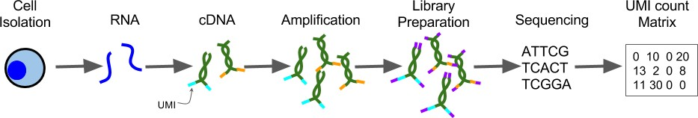
Experimental pipeline
Processing
Regardless of who is going to do the experimental steps, DISCUSS WITH THEM !!!
Experimental design is crucial for the success of a single-cell project !!!
Systematic comparison of single-cell and single-nucleus RNA-sequencing methods, Ding et al., Nat. Biotech. 2020
Notes:
I would like to expand these observations to in vivo data. I also want to check what happens in terms of transcriptional dynamics in cells where Cyclin O, a key non-canonical cyclin involved in MCC diff., is knocked-out.

Slide 3
Analysis workflow
Pre-Processing
Clustering
Biology
Expression Matrix
(GENES x CELLS)
1. Identify
Variable Genes
5. Differentially Expressed Genes
Filter Cells /
Quality Control
2. Dimensionality Reduction
6. Assigning
Cell Type
Normalization
3. Clustering
7. Functional Annotation
4. Explore (known)
marker genes
Notes:
I would like to expand these observations to in vivo data. I also want to check what happens in terms of transcriptional dynamics in cells where Cyclin O, a key non-canonical cyclin involved in MCC diff., is knocked-out.

Slide 4
Analysis workflow
Pre-Processing
Clustering
Biology
Expression Matrix
(GENES x CELLS)
1. Identify
Variable Genes
5. Differentially Expressed Genes
Filter Cells /
Quality Control
2. Dimensionality Reduction
6. Assigning
Cell Type
Normalization
3. Clustering
7. Functional Annotation
4. Explore (known)
marker genes
Notes:
I would like to expand these observations to in vivo data. I also want to check what happens in terms of transcriptional dynamics in cells where Cyclin O, a key non-canonical cyclin involved in MCC diff., is knocked-out.

Slide 5
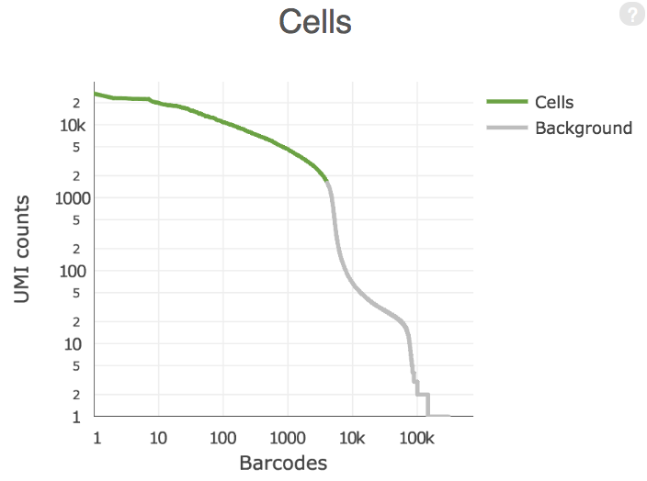
Cellranger count pipeline
Cellranger output
Some cell barcodes have many UMIs, but most do not.
Notes:
I would like to expand these observations to in vivo data. I also want to check what happens in terms of transcriptional dynamics in cells where Cyclin O, a key non-canonical cyclin involved in MCC diff., is knocked-out.

Slide 6
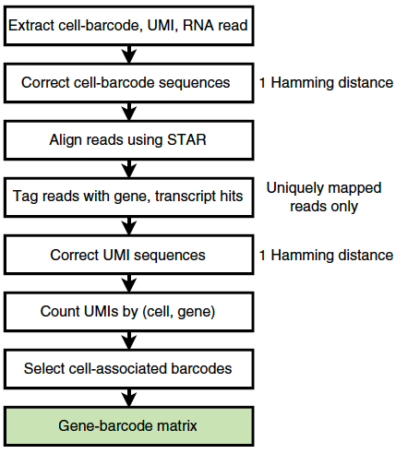
How are cellranger-provided count matrices filtered??
Notes:
I would like to expand these observations to in vivo data. I also want to check what happens in terms of transcriptional dynamics in cells where Cyclin O, a key non-canonical cyclin involved in MCC diff., is knocked-out.

Slide 7
How are cellranger-provided count matrices filtered??
Mystery…
Notes:
I would like to expand these observations to in vivo data. I also want to check what happens in terms of transcriptional dynamics in cells where Cyclin O, a key non-canonical cyclin involved in MCC diff., is knocked-out.

Slide 8
How are cellranger-provided count matrices filtered??
Cell Ranger cell calling algorithm is used to identify the primary mode of high RNA content cells, using a cutoff based on the total UMI count for each barcode.
Cell Ranger takes as input the expected number of recovered cells, N (see --expect-cells). Let m be the 99th percentile of the top N barcodes by total UMI counts. All barcodes whose total UMI counts exceed m/10 are called as cells.
Notes:
I would like to expand these observations to in vivo data. I also want to check what happens in terms of transcriptional dynamics in cells where Cyclin O, a key non-canonical cyclin involved in MCC diff., is knocked-out.

Slide 9
How are cellranger-provided count matrices filtered??
1000 expected cells
→ Check m the total UMI counts for the 990th droplet (ranked by total UMI counts) (e.g.: m = 5000).
Notes:
I would like to expand these observations to in vivo data. I also want to check what happens in terms of transcriptional dynamics in cells where Cyclin O, a key non-canonical cyclin involved in MCC diff., is knocked-out.

Slide 10
How are cellranger-provided count matrices filtered??
1000 expected cells
→ Check m the total UMI counts for the 990th droplet (ranked by total UMI counts) (e.g.: m = 5000).
→ Any droplet with more than m/10 ( = 500) total UMI counts) is annotated as a cell.
Notes:
I would like to expand these observations to in vivo data. I also want to check what happens in terms of transcriptional dynamics in cells where Cyclin O, a key non-canonical cyclin involved in MCC diff., is knocked-out.

Slide 11
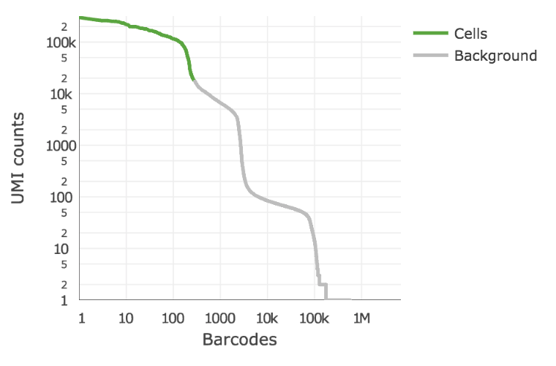
How are cellranger-provided count matrices filtered??
Problem: cell populations with varying amounts of RNA!
Notes:
I would like to expand these observations to in vivo data. I also want to check what happens in terms of transcriptional dynamics in cells where Cyclin O, a key non-canonical cyclin involved in MCC diff., is knocked-out.

Slide 12
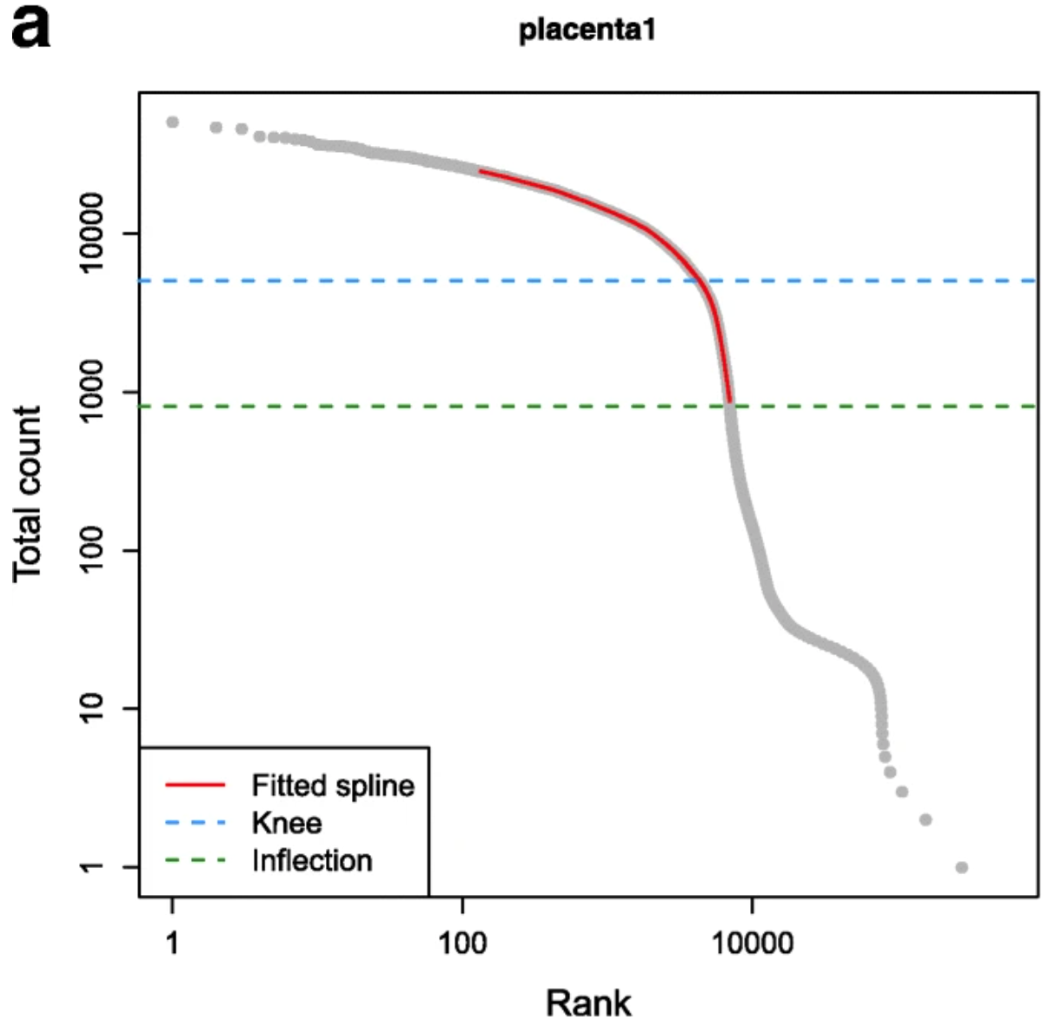
How are cellranger-provided count matrices filtered??
emtpyDrops:
Any droplet above the ”knee point”
Any cell whose RNA content varies from the profile of ambient RNA pool (estimated using cells with low UMI counts)
Lun et al., Genome Res. 2019
Notes:
I would like to expand these observations to in vivo data. I also want to check what happens in terms of transcriptional dynamics in cells where Cyclin O, a key non-canonical cyclin involved in MCC diff., is knocked-out.

Slide 13
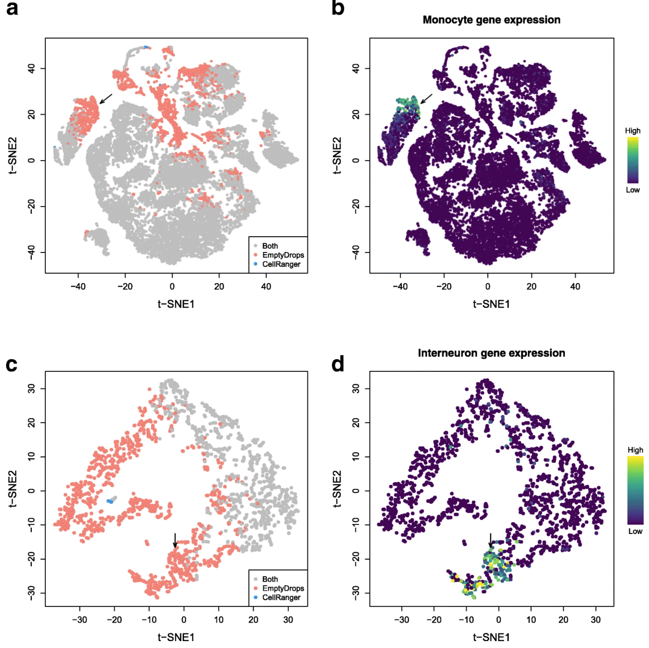
How are cellranger-provided count matrices filtered??
emtpyDrops:
Any droplet above the ”knee point”
Any cell whose RNA content varies from the profile of ambient RNA pool (estimated using cells with low UMI counts)
Total RNA content in a cell is often associated with its biology!
Don’t miss out on some cell types!
Lun et al., Genome Res. 2019
Notes:
I would like to expand these observations to in vivo data. I also want to check what happens in terms of transcriptional dynamics in cells where Cyclin O, a key non-canonical cyclin involved in MCC diff., is knocked-out.

Slide 14
Analysis workflow
Pre-Processing
Clustering
Biology
Expression Matrix
(GENES x CELLS)
1. Identify
Variable Genes
5. Differentially Expressed Genes
Filter Cells /
Quality Control
2. Dimensionality Reduction
6. Assigning
Cell Type
Normalization
3. Clustering
7. Functional Annotation
4. Explore (known)
marker genes
Notes:
I would like to expand these observations to in vivo data. I also want to check what happens in terms of transcriptional dynamics in cells where Cyclin O, a key non-canonical cyclin involved in MCC diff., is knocked-out.

Slide 15
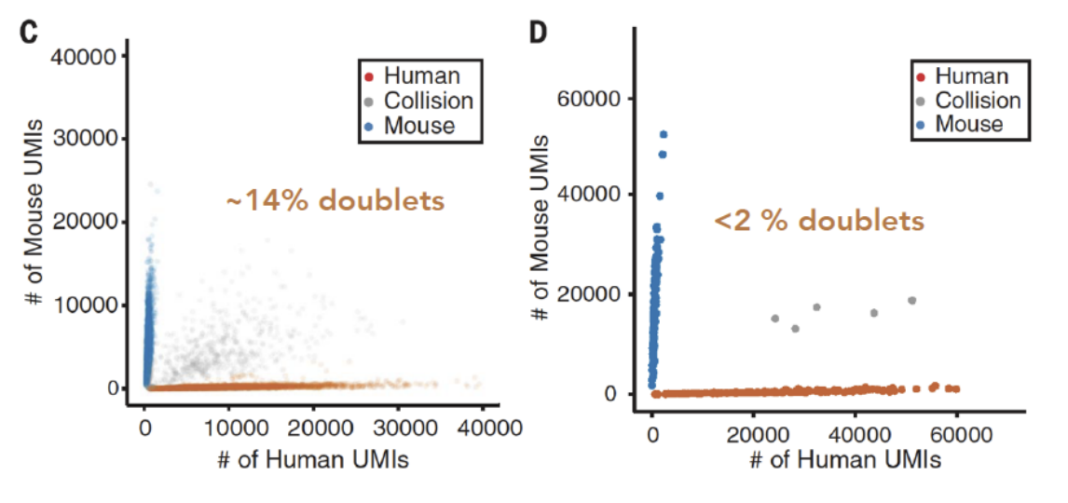
Doublet rate can be estimated experimentally
Few thousand cells
Few hundred cells
Karthik Shekhar
Notes:
I would like to expand these observations to in vivo data. I also want to check what happens in terms of transcriptional dynamics in cells where Cyclin O, a key non-canonical cyclin involved in MCC diff., is knocked-out.

Slide 16
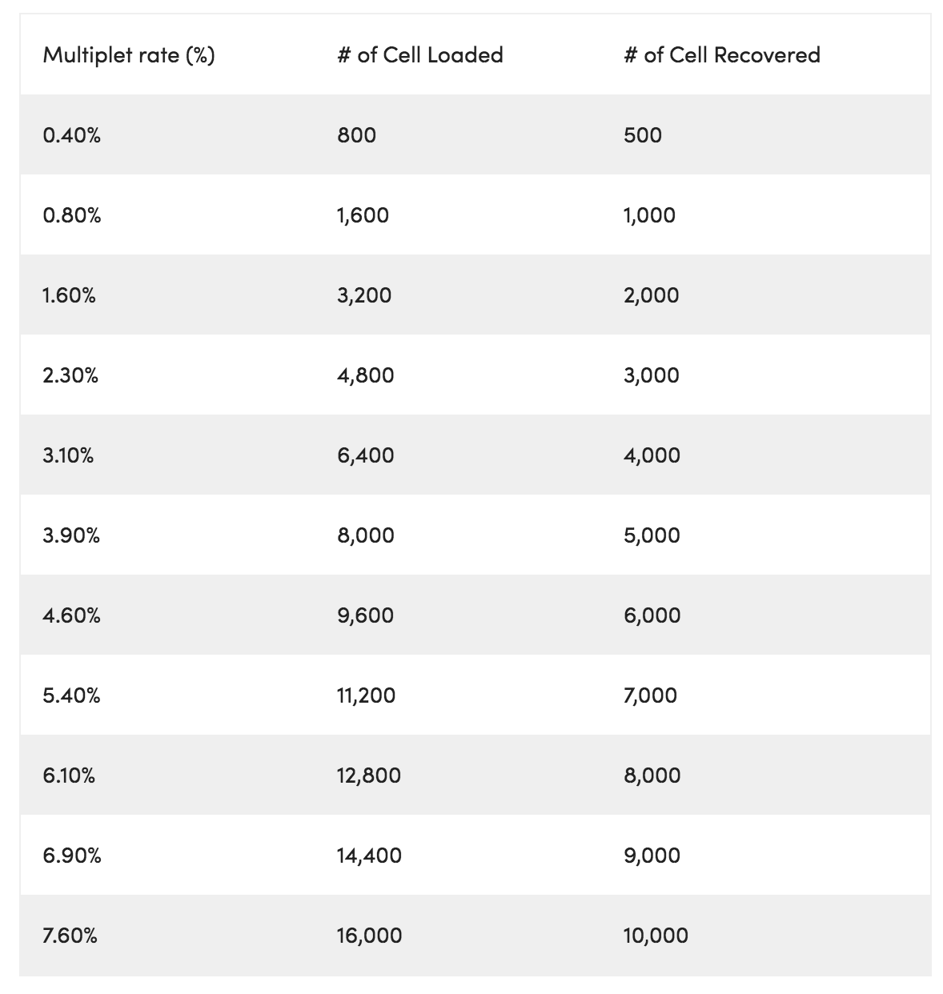
Droplet-based approaches favor doublet detection
Chromium instrument produces cell multiplets in increasing % when loading up the cassette.
10X Genomics User Guide
Notes:
I would like to expand these observations to in vivo data. I also want to check what happens in terms of transcriptional dynamics in cells where Cyclin O, a key non-canonical cyclin involved in MCC diff., is knocked-out.

Slide 17
Droplet-based approaches favor doublet detection
Removing cell doublets is necessary when sequencing few thousand cells !!
10X Genomics User Guide
Notes:
I would like to expand these observations to in vivo data. I also want to check what happens in terms of transcriptional dynamics in cells where Cyclin O, a key non-canonical cyclin involved in MCC diff., is knocked-out.

Slide 18
Multiplet detection algorithms
Several different approaches:
Exploiting natural genetic variation when pooling cells from multiple donor individuals
Kang et al., Nature Biotech. 2017:
Doublets can be identified as libraries with allele combinations that do not exist in any single donor
Notes:
I would like to expand these observations to in vivo data. I also want to check what happens in terms of transcriptional dynamics in cells where Cyclin O, a key non-canonical cyclin involved in MCC diff., is knocked-out.

Slide 19
Multiplet detection algorithms
Several different approaches:
Marking a subset of cells (e.g., all cells from one sample) with an antibody conjugated to a different oligonucleotide
Stoeckius et al., Genome Biology 2018:
Upon pooling, libraries that are observed to have different oligonucleotides are considered to be doublets and removed
Notes:
I would like to expand these observations to in vivo data. I also want to check what happens in terms of transcriptional dynamics in cells where Cyclin O, a key non-canonical cyclin involved in MCC diff., is knocked-out.

Slide 20
Multiplet detection algorithms
Algorithmic approaches:
DoubletFinder - [R] - Doublet detection in single-cell RNA sequencing data using artificial nearest neighbors.
DoubletDecon - [R] - Cell-State Aware Removal of Single-Cell RNA-Seq Doublets.
DoubletDetection - [Python] - A Python3 package to detect doublets in single-cell RNA-seq count matrices.
Scrublet - [Python] - Computational identification of cell doublets in single-cell transcriptomic data.
solo - [Python] - Doublet detection via semi-supervised deep learning.
scDblFinder – [R]
Notes:
I would like to expand these observations to in vivo data. I also want to check what happens in terms of transcriptional dynamics in cells where Cyclin O, a key non-canonical cyclin involved in MCC diff., is knocked-out.

Slide 21
Multiplet detection algorithms
scDblFinder & findDoubletClusters():
Identifies clusters with expression profiles lying between two other clusters:
We consider every possible triplet of clusters consisting of a query cluster and two putative “source” clusters. Under the null hypothesis that the query consists of doublets from the two sources, we compute the number of genes that are differentially expressed in the same direction in the query cluster compared to both of the source clusters.
Clusters are then ranked by the number of DE genes, where those with the few unique genes are more likely to be composed of doublets
Notes:
I would like to expand these observations to in vivo data. I also want to check what happens in terms of transcriptional dynamics in cells where Cyclin O, a key non-canonical cyclin involved in MCC diff., is knocked-out.

Slide 22
Multiplet detection algorithms
scDblFinder & findDoubletClusters():
Identifies clusters with expression profiles lying between two other clusters:
We consider every possible triplet of clusters consisting of a query cluster and two putative “source” clusters. Under the null hypothesis that the query consists of doublets from the two sources, we compute the number of genes that are differentially expressed in the same direction in the query cluster compared to both of the source clusters.
Clusters are then ranked by the number of DE genes, where those with the few unique genes are more likely to be composed of doublets
This works for cluster-structured datasets!! It should not be used for cellular trajectories!!
Notes:
I would like to expand these observations to in vivo data. I also want to check what happens in terms of transcriptional dynamics in cells where Cyclin O, a key non-canonical cyclin involved in MCC diff., is knocked-out.

Slide 23
Multiplet detection algorithms
scDblFinder & computeDoubletDensity():
Simulate thousands of doublets by adding together two randomly chosen single-cell profiles.
For each original cell, compute the density of simulated doublets in the surrounding neighborhood.
For each original cell, compute the density of other observed cells in the neighborhood.
Return the ratio between the two densities as a “doublet score” for each cell.
The advantage of computeDoubletDensity() is that it does not depend on clusters, reducing the sensitivity of the results to clustering quality.
Notes:
I would like to expand these observations to in vivo data. I also want to check what happens in terms of transcriptional dynamics in cells where Cyclin O, a key non-canonical cyclin involved in MCC diff., is knocked-out.

Slide 24
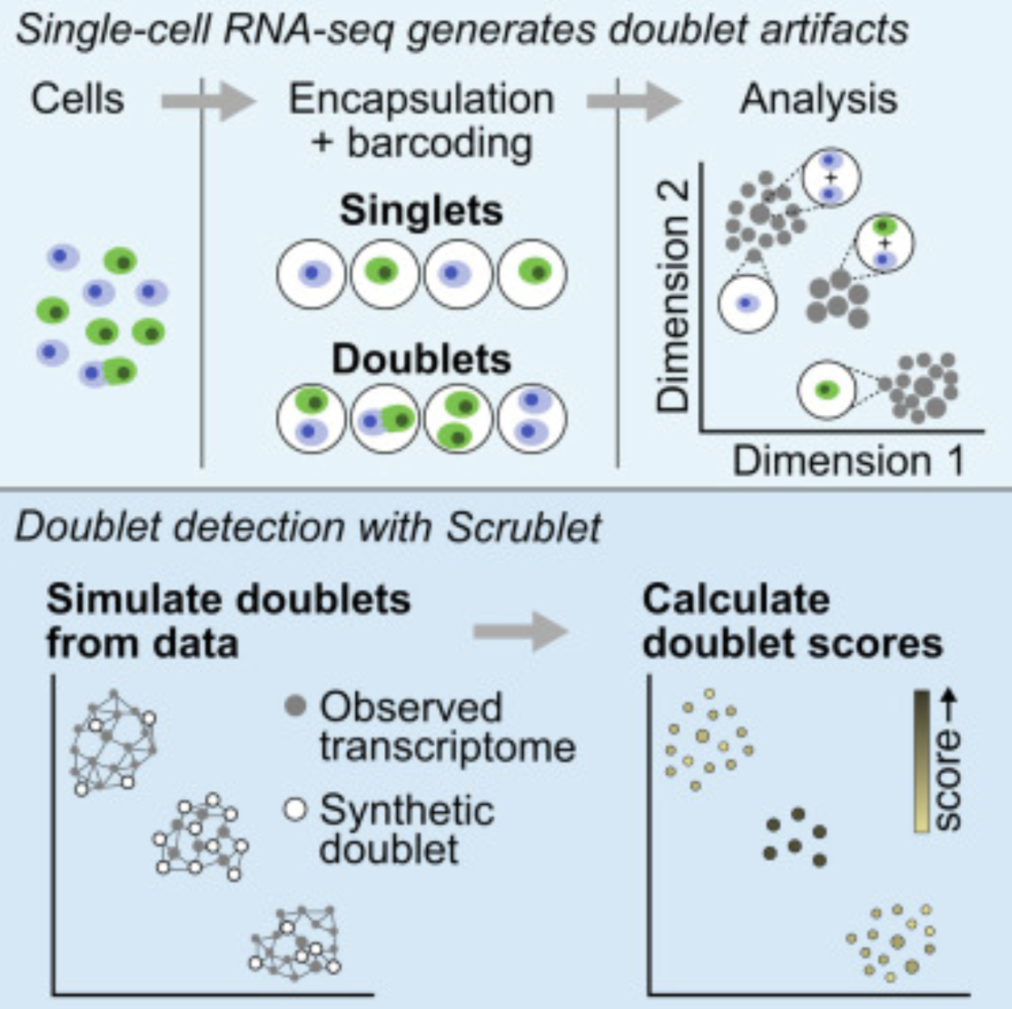
Multiplet detection algorithms
Scrublet [python]
Wolock et al., Cell Systems 2019
Notes:
I would like to expand these observations to in vivo data. I also want to check what happens in terms of transcriptional dynamics in cells where Cyclin O, a key non-canonical cyclin involved in MCC diff., is knocked-out.

Slide 25
Multiplet detection algorithms
scDblFinder general approach:
x <- scDblFinder::scDblFinder(x)
## Clustering cells...
## 13 clusters
## Creating ~5000 artifical doublets...
## Dimensional reduction
## Evaluating kNN...
## Training model...
## iter=0, 208 cells excluded from training.
## Threshold found:0.33
## 219 (3.5%) doublets called
table(x$scDblFinder.class)
## singlet doublet
## 5960 219
Notes:
I would like to expand these observations to in vivo data. I also want to check what happens in terms of transcriptional dynamics in cells where Cyclin O, a key non-canonical cyclin involved in MCC diff., is knocked-out.

Slide 26
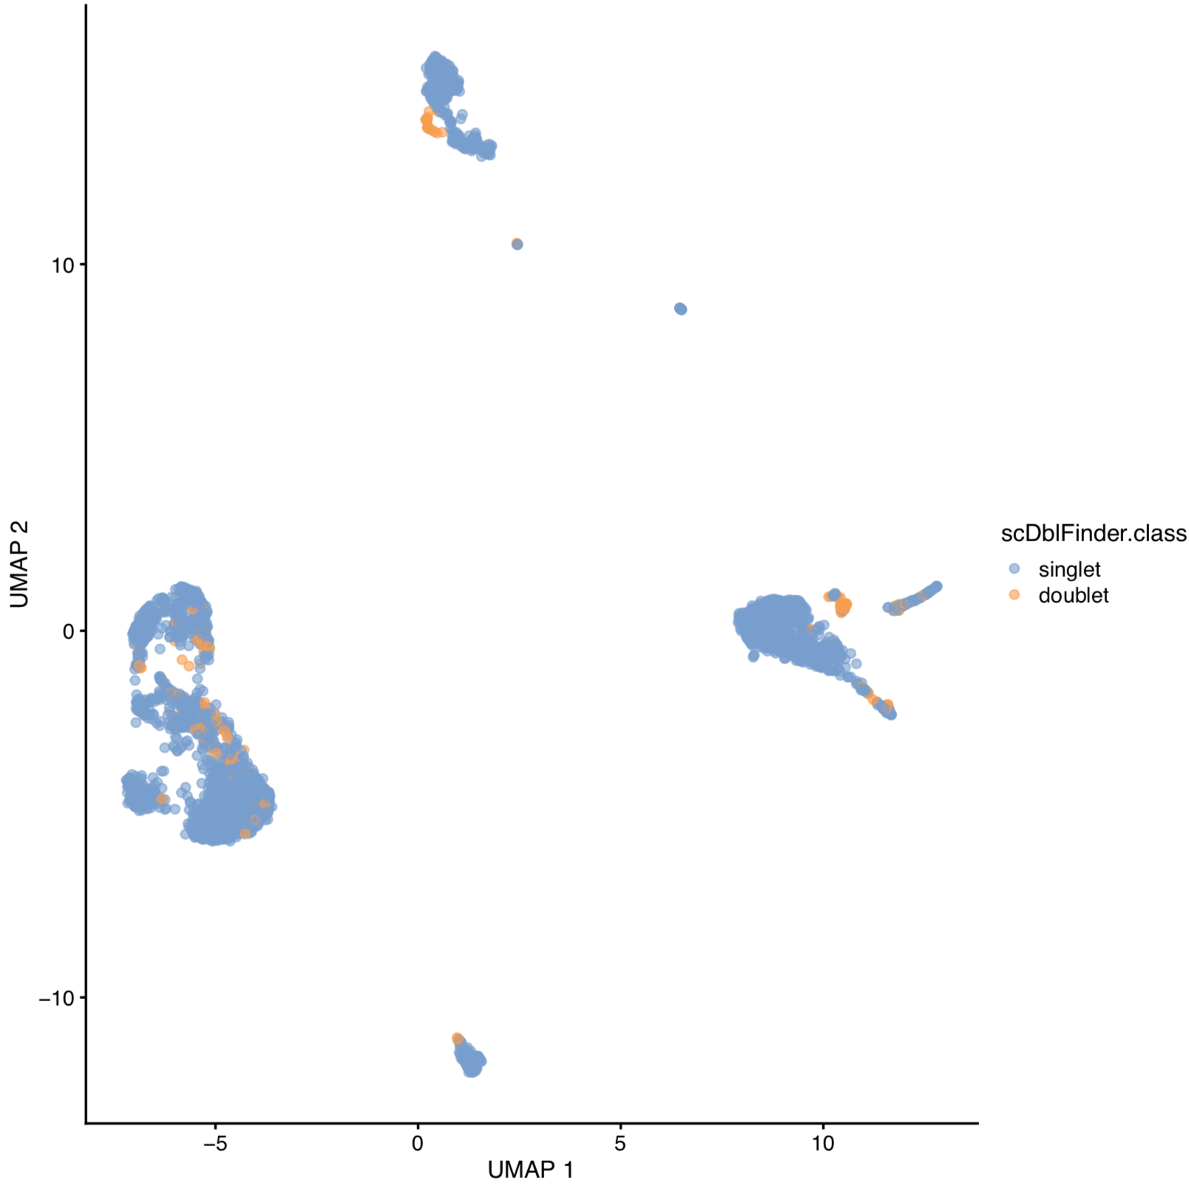
Multiplet detection algorithms
10X 4K PBMC dataset
Notes:
I would like to expand these observations to in vivo data. I also want to check what happens in terms of transcriptional dynamics in cells where Cyclin O, a key non-canonical cyclin involved in MCC diff., is knocked-out.

Slide 27
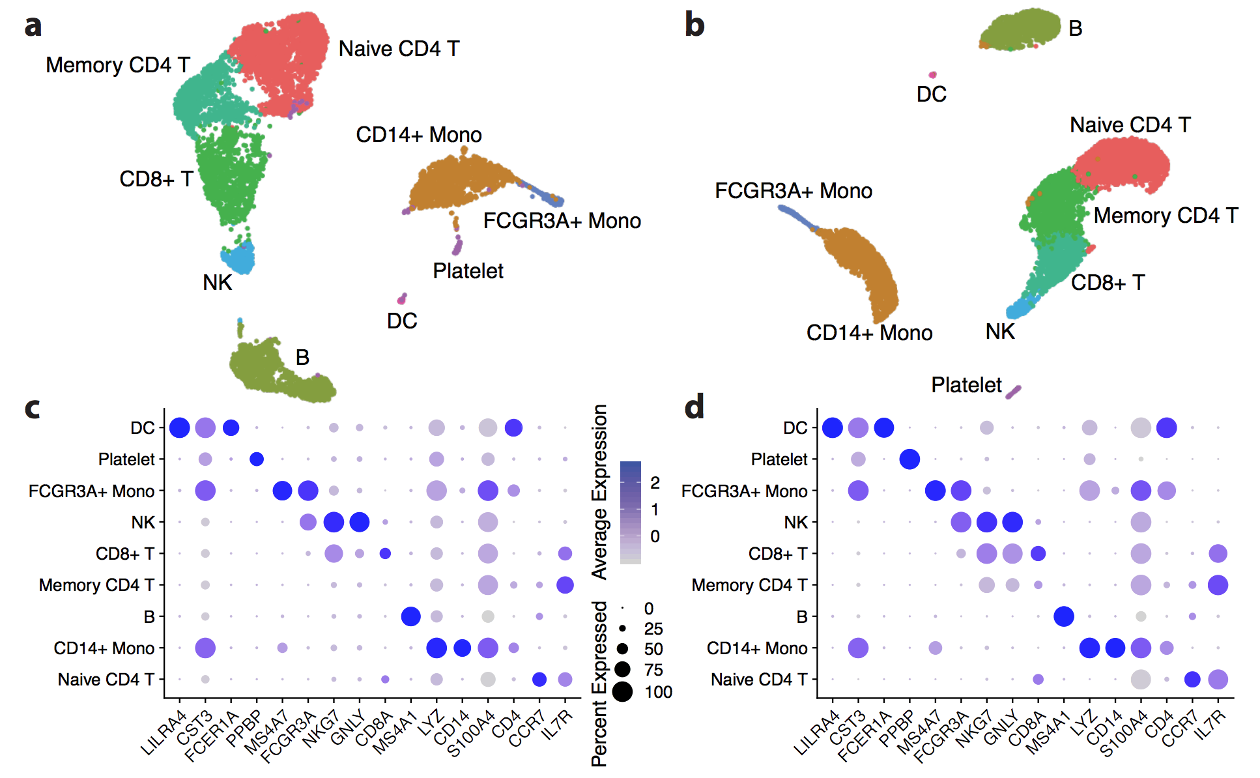
Multiplet detection algorithms
10X 4K PBMC dataset
Without doublet removal
With doublet removal [CellBender]
Fleming et al., 2019
Notes:
I would like to expand these observations to in vivo data. I also want to check what happens in terms of transcriptional dynamics in cells where Cyclin O, a key non-canonical cyclin involved in MCC diff., is knocked-out.

Slide 28
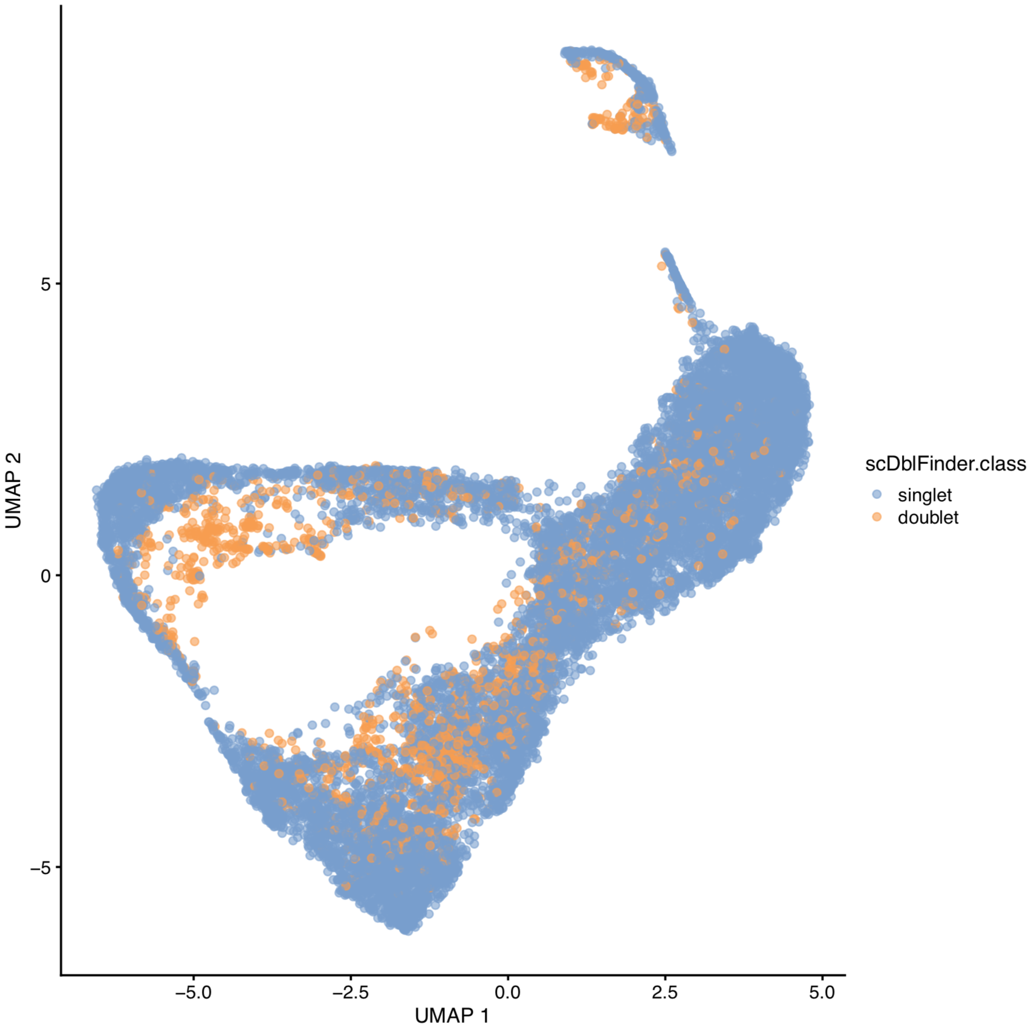
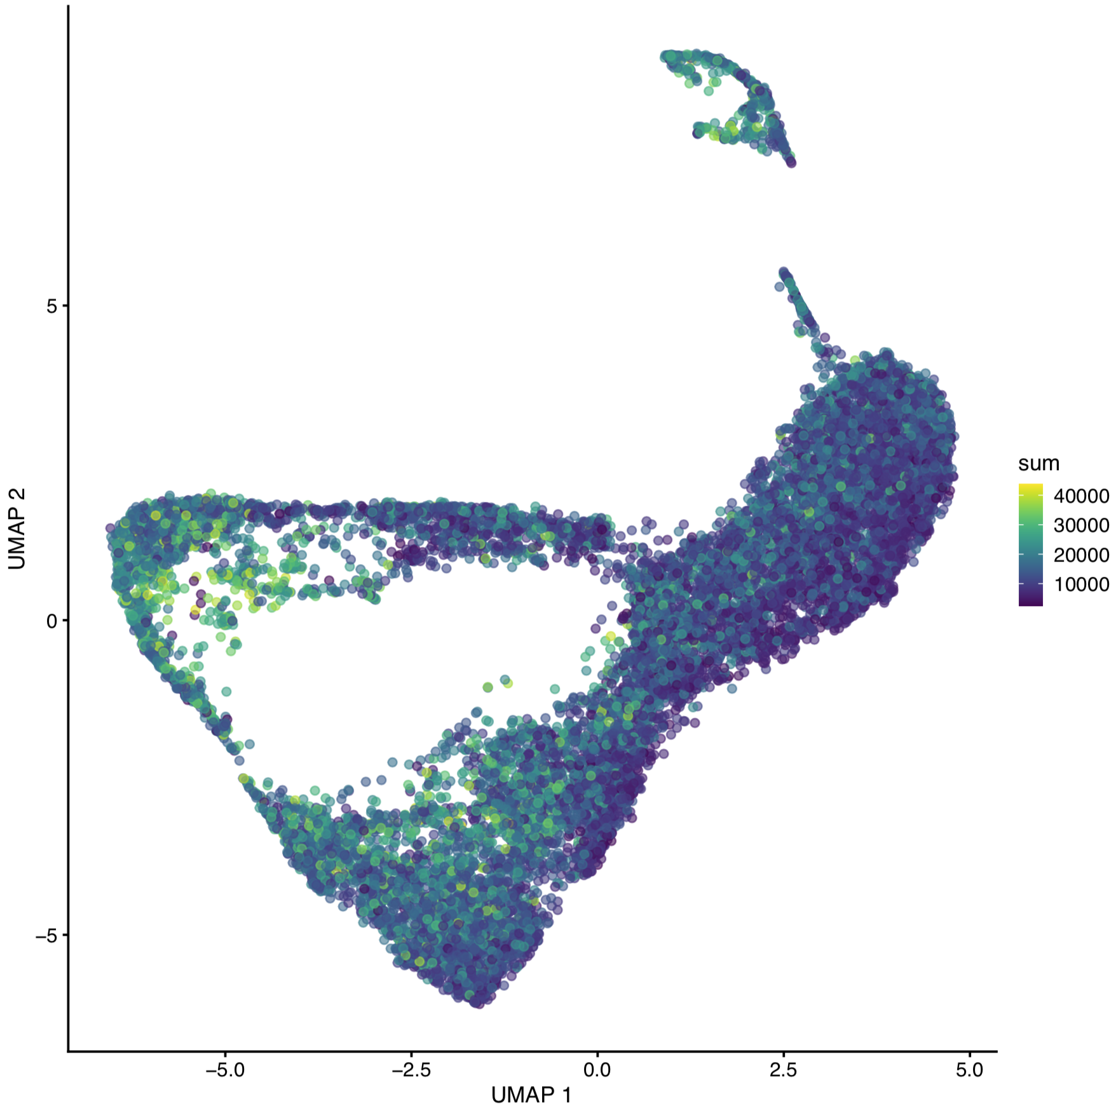
Multiplet detection algorithms
Be careful! Some biological behaviours can be detected as “doublets”…
Cells in G2 (G2-like) with twice as much RNA content
Notes:
I would like to expand these observations to in vivo data. I also want to check what happens in terms of transcriptional dynamics in cells where Cyclin O, a key non-canonical cyclin involved in MCC diff., is knocked-out.

Slide 29
Sequencing depth
How deeply do I need to sequence?
- At high sequencing depth, we can detect:
The expression of rare splice variants.
Quantitative modulations in transcript abundance.
- Lower sequencing depth can still be very powerful :
Catalog of cell types.
Catalog of transcriptional programs.
Notes:
I would like to expand these observations to in vivo data. I also want to check what happens in terms of transcriptional dynamics in cells where Cyclin O, a key non-canonical cyclin involved in MCC diff., is knocked-out.

Slide 30
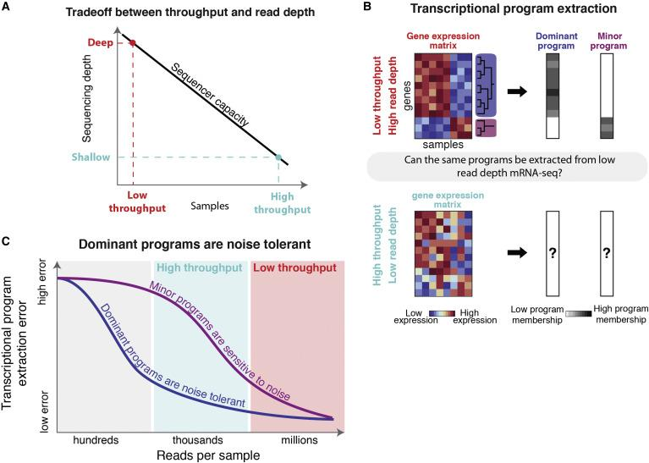
Sequencing depth
How deeply do I need to sequence?
Notes:
I would like to expand these observations to in vivo data. I also want to check what happens in terms of transcriptional dynamics in cells where Cyclin O, a key non-canonical cyclin involved in MCC diff., is knocked-out.

Slide 31
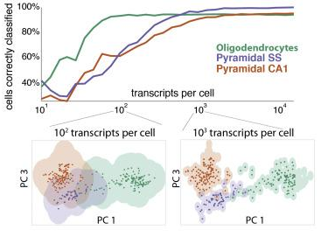
Sequencing depth
How deeply do I need to sequence?
Heimberg et al. Low Dimensionality in Gene Expression Data Enables the Accurate Extraction of Transcriptional Programs from Shallow Sequencing. Cell Systems 2016.
https://satijalab.org/costpercell/
Notes:
I would like to expand these observations to in vivo data. I also want to check what happens in terms of transcriptional dynamics in cells where Cyclin O, a key non-canonical cyclin involved in MCC diff., is knocked-out.

Slide 32
Sequencing depth
How deeply do I need to sequence?
Early scRNAseq studies used to sequence each cell to > 10 million reads / cell.
This is outrageously costly and wasteful!!
~ 50,000 – 100,000 reads/cell is now widely regarded as sufficient for most applications.
Notes:
I would like to expand these observations to in vivo data. I also want to check what happens in terms of transcriptional dynamics in cells where Cyclin O, a key non-canonical cyclin involved in MCC diff., is knocked-out.

